Slide 1
The Enlisted Association Chapter 39
15821 E Centretech Cir
Aurora Co 80011
15821 E Centretech Cir
Aurora CO 80011
303-340-3939
July, August, and September 2023

Slide 2
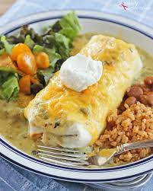
A WORD FROM THE PRESIDENT
THINGS TO DO AT CHAPTER 39
SEE CALENDARS FOR DETAILS
Here we are in July already! There’s a lot going on at TREA Chapter #39 this month, August, and into September. As you know we are in the process of moving to a new location at Buckley and Iliff Ave in Aurora. A new chapter in Chapter 39’s history is about to begin.
We will need your help with the packing and moving of everything if you are able to assist. There will be a sheet at the club listing the days and times that will be available for you to sign up to help.
We appreciate each and every one of you and all you have done (and will do) for TREA Chapter #39.
Hoping to see you at the Club for one of our upcoming fun events!
United We Stand
Mary Clarvoe, President
TREA Chapter 39
A WORD FROM THE AUXILIARY
I want to thank all who come to our dinners or buy our baked goods. Without you we couldn’t do what we do!
Our winner for the June raffle was Jeal Lefebvre. Thank you, Barbara, for all your work putting the basket for the raffle together. Also want to thank all the members who have been helping with the dinners and the and bake sales.
Our next wine tasting will be September 24th. We hope you’ll join us for the food, fun, friendship, and of course the wine.
Our meeting for the Auxiliary is on the 3rd Sunday of every month at 1:00pm. We’d love to see everyone there.
United We Stand
Helen Suggs, President
TREA Chapter 39
September 2nd 5:30-7pm
Bison Burger Dinner July 16th
October 1st 5:30-7pm
MANAGER’S MINUTE
Greetings,
Happy summer of 2023. The weather is getting hotter, and the beer is always cold. The conversations about the new place have brought some of you in, but we’d love to see more of you. Want to see an even we don’t already have on the calendar? Reach out to myself or a member of the A&E Committee and let us know what it is! We’ll be looking for everyone’s help packing before we move (and manning the yard sales that is going to happen).
As always, this is your Club, come in and enjoy it!
Charlie Keith
Club Manager
Queen of Hearts drawing every Saturday at 7:00pm.

Slide 3
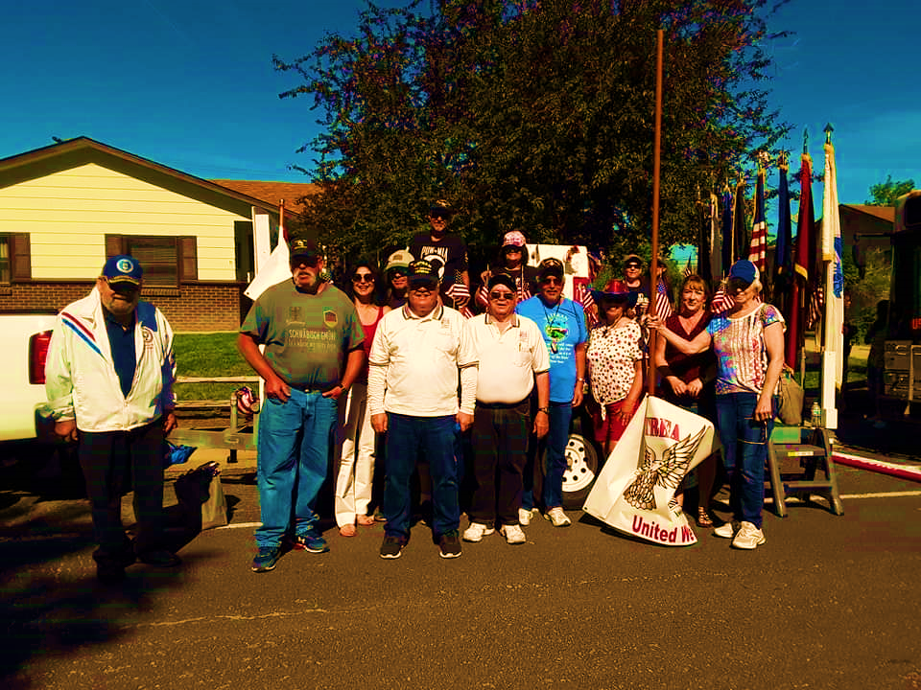
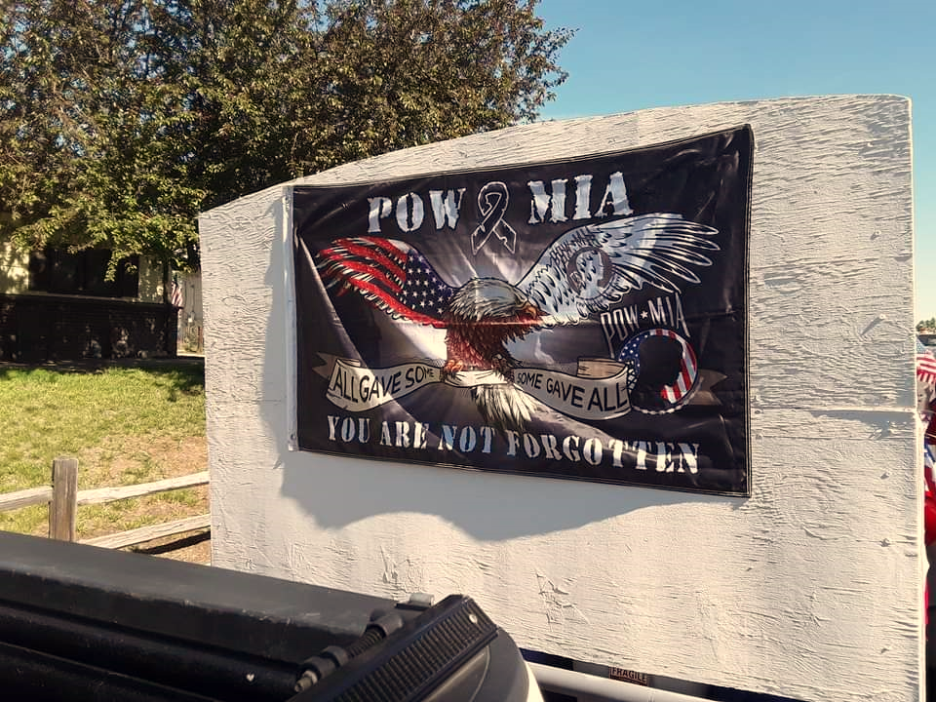
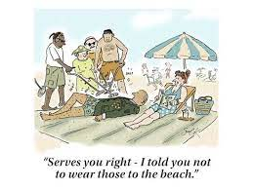
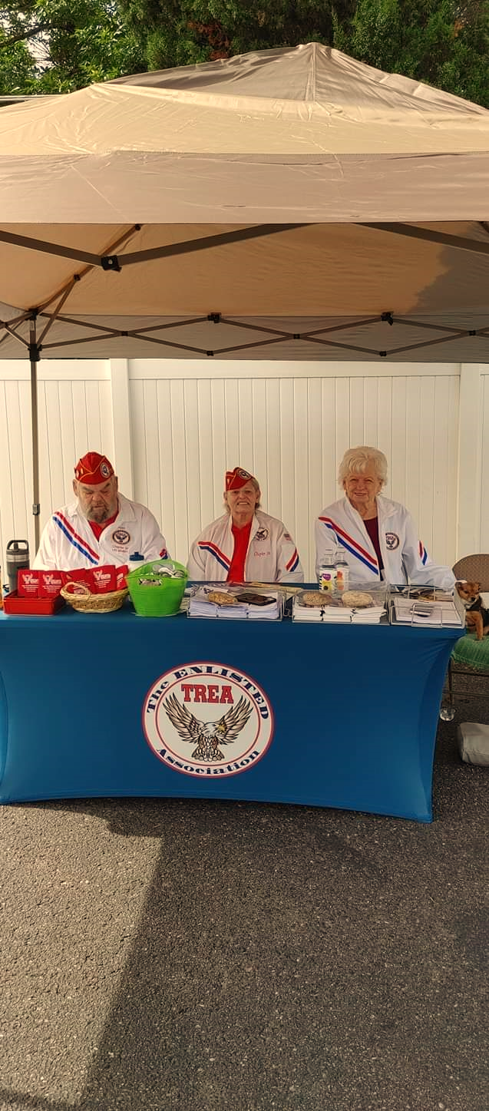
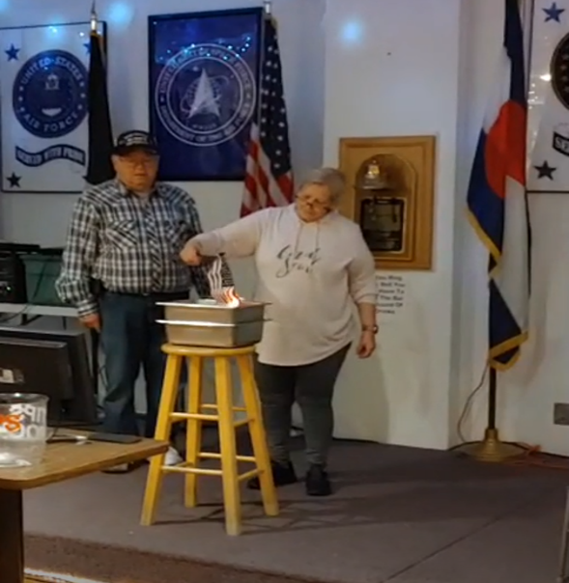
CLUB WISH LIST
Want to help out your club but are limited for time? Here are a few things that we consistently need and would appreciate having donated:
Bar snacks 13 Gallon trash bags
Paper dinner/cake plates 50 Gallon trash bags
Dinner napkins Paper salad bowls
Plastic silverware Red solo cups
Packing Tape Newspapers / packing paper
Scissors
WHAT WE’VE BEEN UP TO RECENTLY
Chapter #39 looking good at the parade!
Making new friends and partnering with other organizations!
“I’d like to live like a poor man – only with lots of money.”
~Pablo Picasso
Short and sweet, ceremonial flag retirement took place inside due to rain

Slide 4
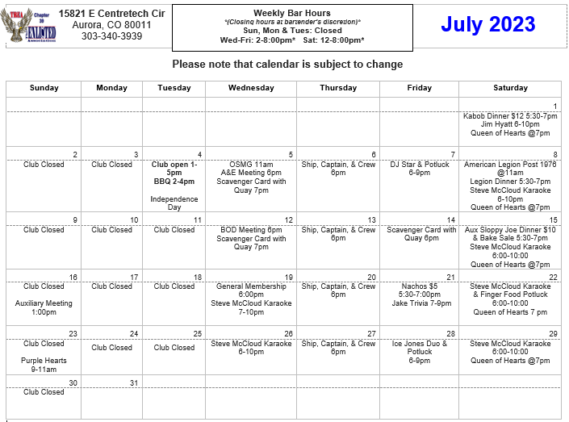

Slide 5
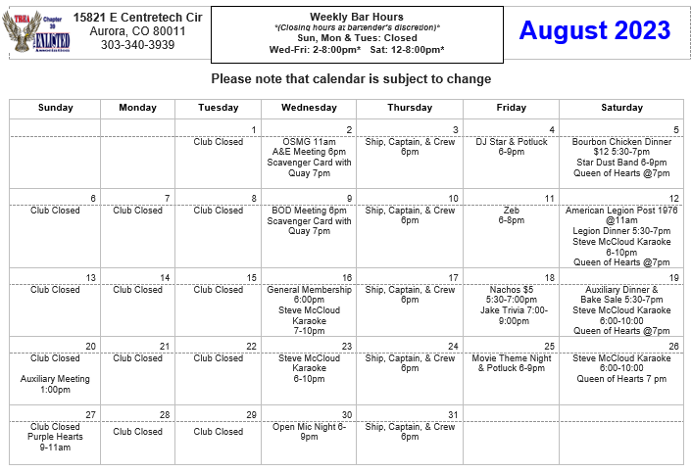

Slide 6
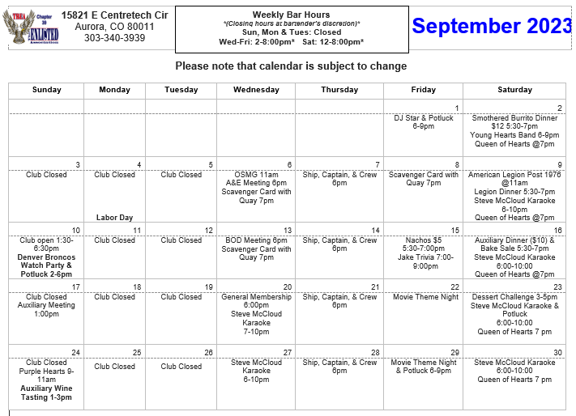
Q: What did the football coach say to the broken vending machine? A: Give me my quarterback!

